Slide 1




KIET GROUP OF INSTITUTIONS
MLSA KIET INTERNSHIP
CALCULATOR MADE IT EASY
DOMAIN: FULL STACK WEB DEVELOPMENT
Name- Kumari Chetana
Department- Computer Science
Roll no.- 2200290120093

Slide 2

PROBLEM STATEMENT
Develop a web-based calculator application using JavaScript to perform basic arithmetic operations (addition, subtraction, multiplication, and division). The application should have a simple, intuitive interface, handle edge cases (e.g., division by zero), and provide accurate results for a seamless user experience.

Slide 3

SOLUTION
1.UI Design: Create a simple HTML layout with number and operation buttons, and a display screen.
2. JavaScript Logic: Implement functions for arithmetic operations and handle edge cases like division by zero.
3. Styling: Apply CSS for a clean look and ensure responsive design for all devices.

Slide 4

TECH STACK
HTML
CSS
JAVASCRIPT

Slide 5
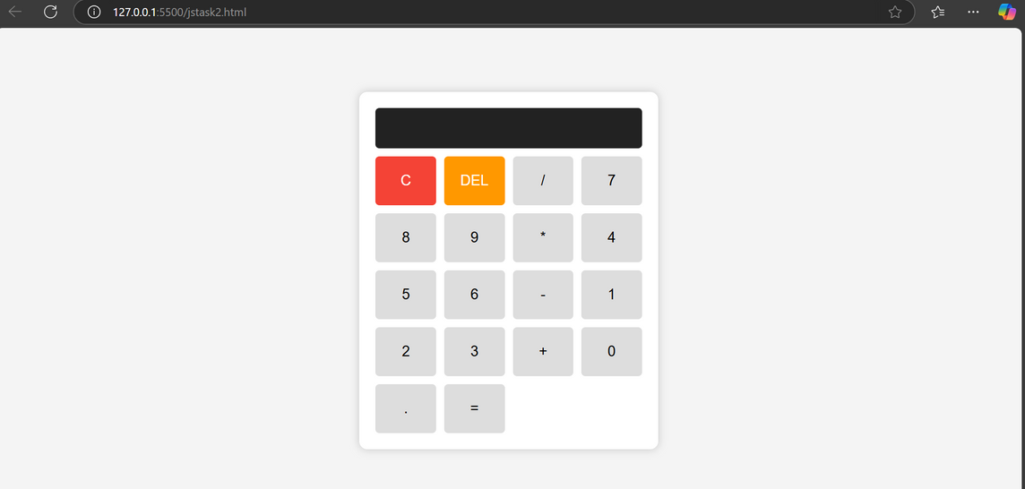
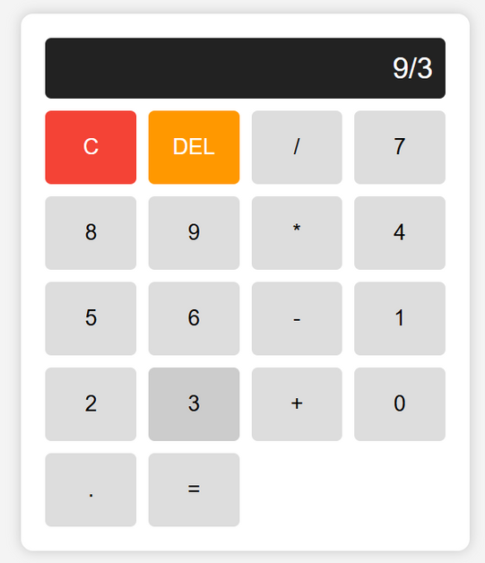
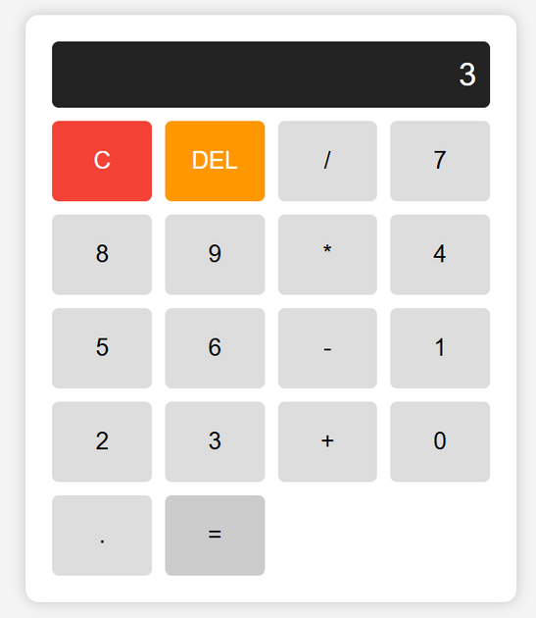
PROJECT OVERVIEW

Slide 6
THANK YOU!

